Slide 1
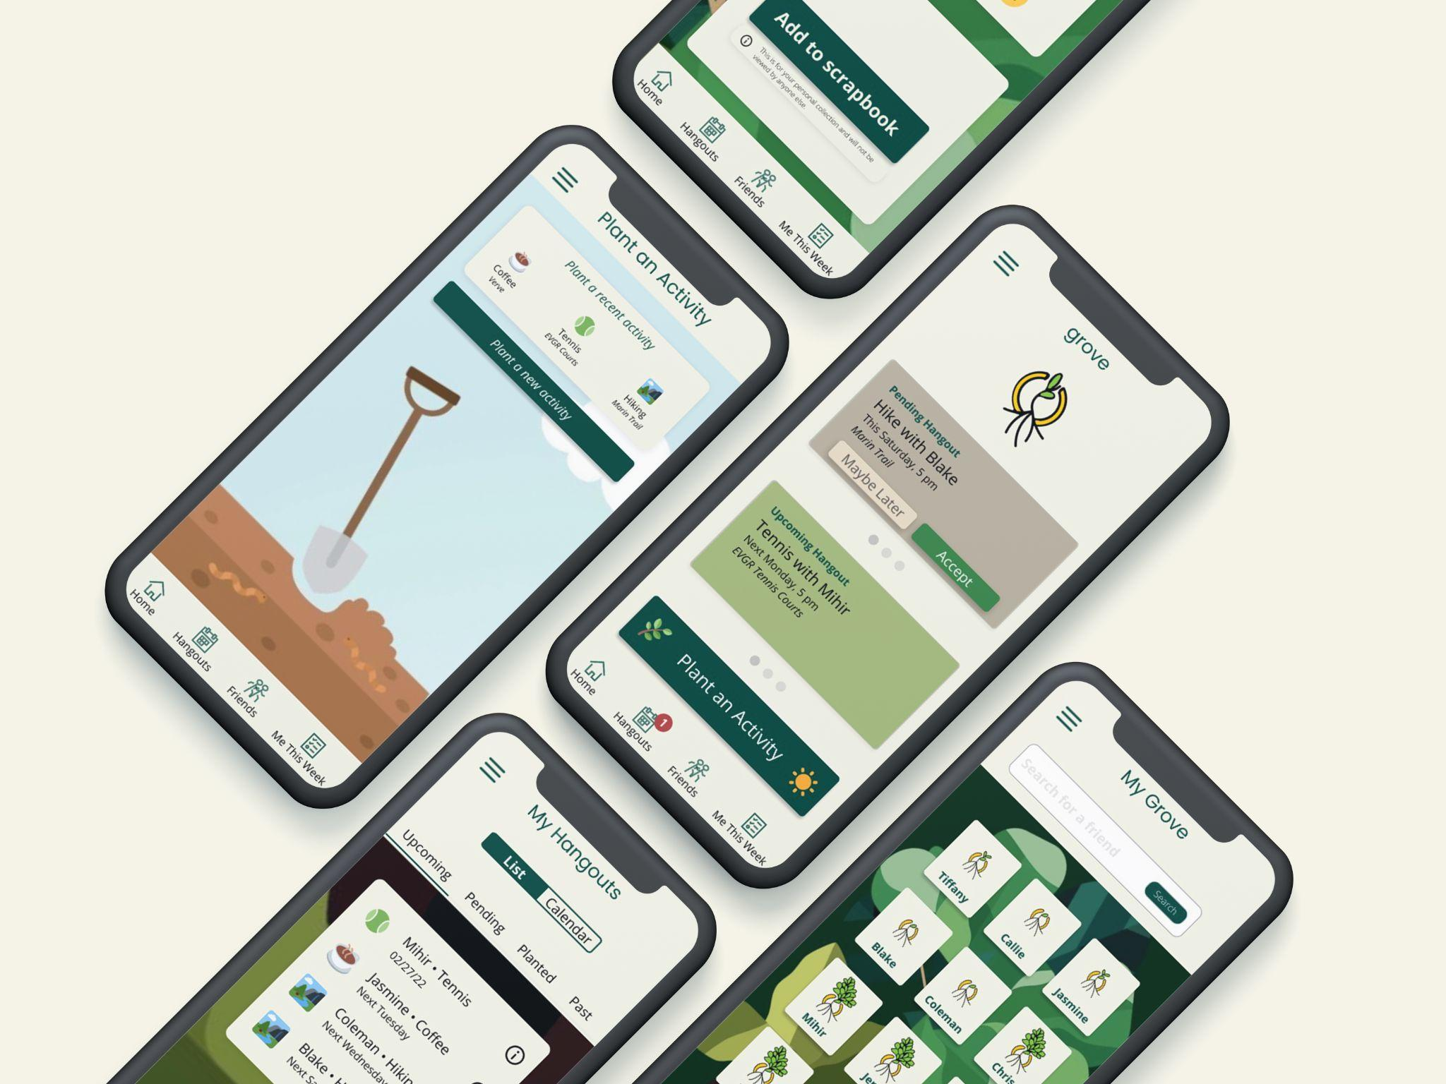
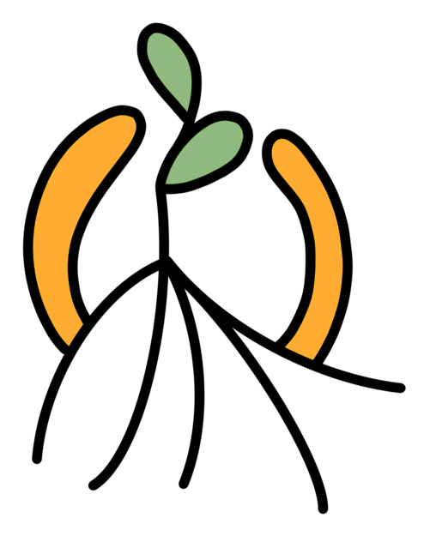
grove
Midway Milestone Presentation

Slide 2
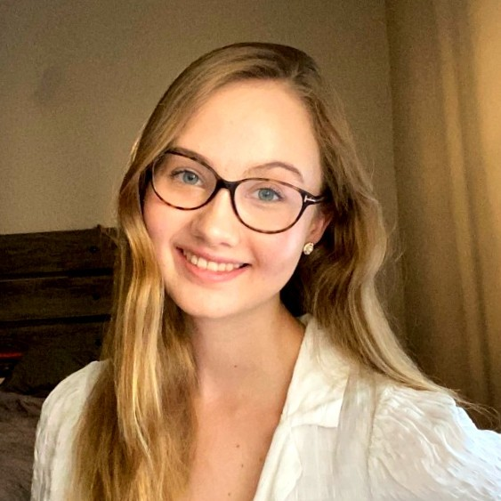
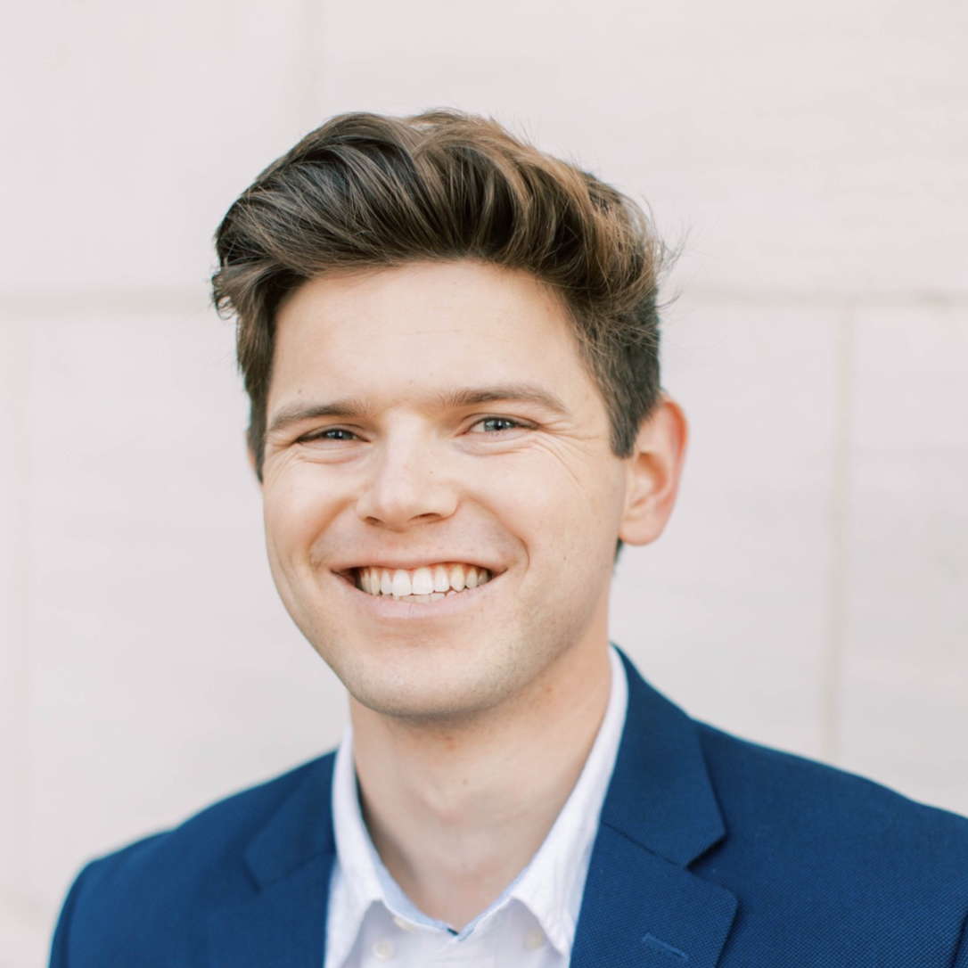
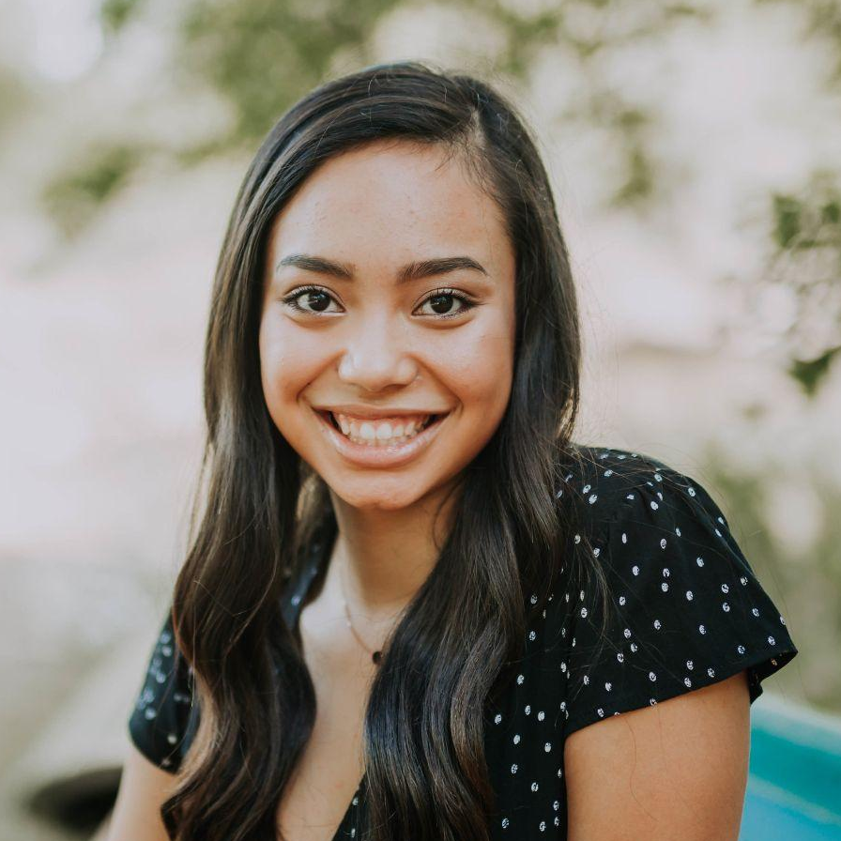
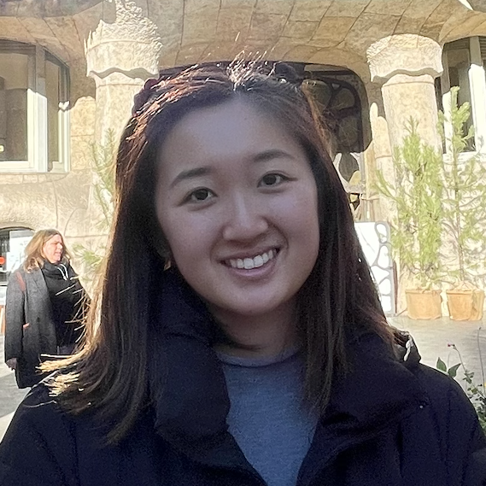
team
Amelia W.
Chris M.
Jasmine R.
Tiff L.
Senior
Math & CS
Junior
SymSys
Senior
MS&E & CS
Senior
SymSys & English

Slide 3
value proposition
problem/solution overview
Cultivate your post-grad community.
Post-grads are faced with the often-overwhelming challenge of building and retaining friendships amidst a sea of new connections. Grove allows post-grads to focus on the enjoyable and exciting aspects of building community by simplifying the stressful aspects of inviting, planning, and following up with new friends. Grove helps ensure that new friendships deepen into lasting friendships without the anxiety that currently accompanies post-grad community building.

Slide 4
heuristic evaluation results
+ revised design

Slide 5
heuristic evaluation overview
43
7
Severity 3 & 4 Violations
All addressed
36
Severity 1 & 2 Violations¹
33/36 addressed
Total violations
1. See appendix for design changes to address severity 1 & 2 violations and rationale for unaddressed violations

Slide 6
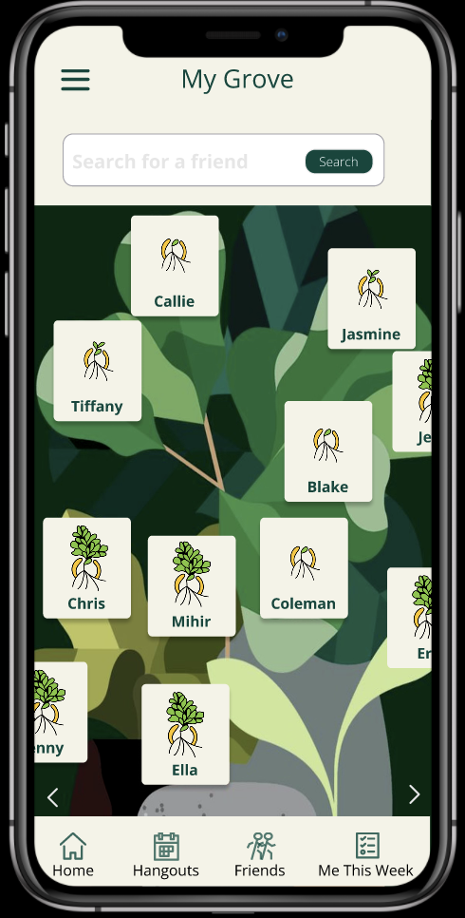
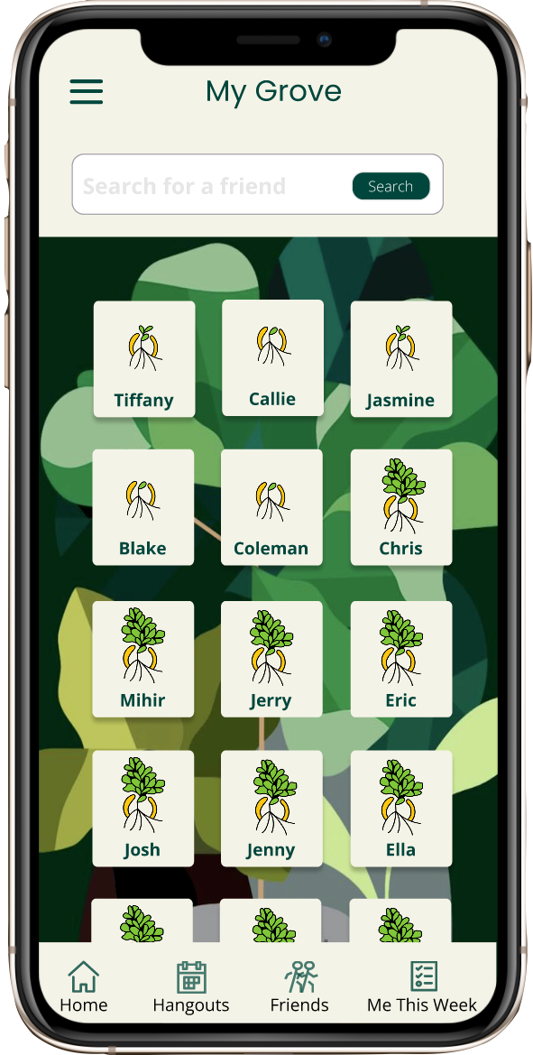
my grove design changes: severity 3 & 4
violation
Scattered layout is confusing, doesn’t add to design
fix
Simplified to grid layout with vertical scroll to ease confusion

Slide 7
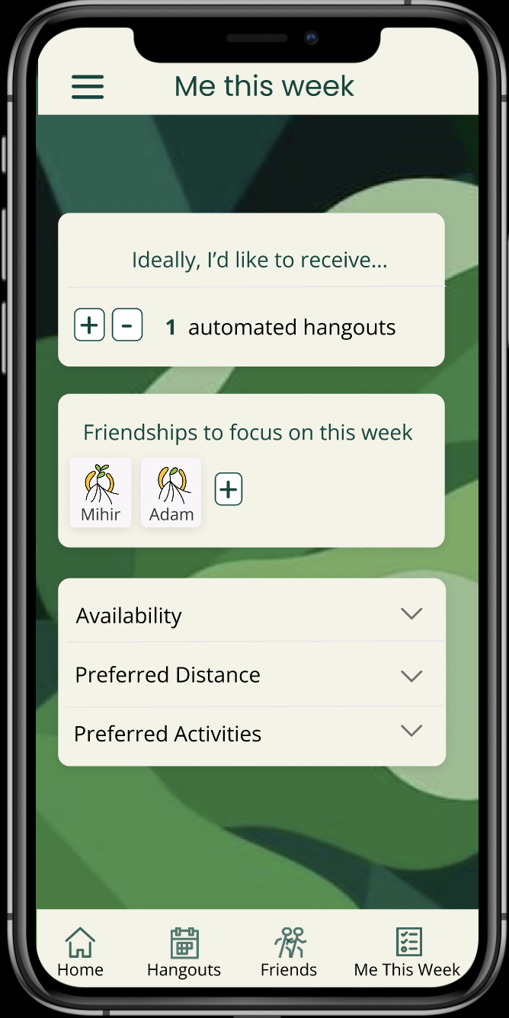
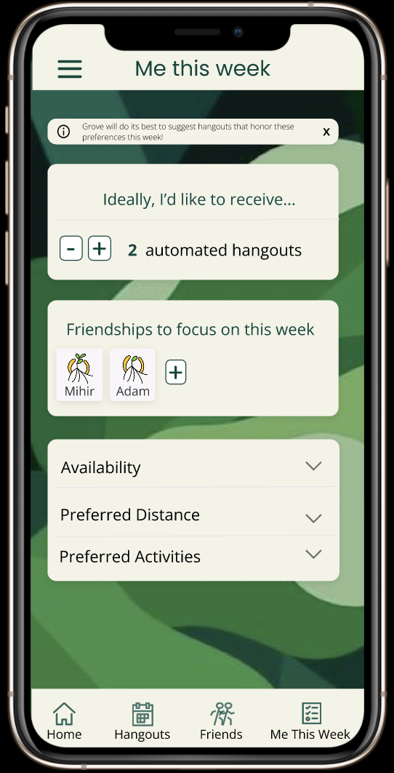
me this week design changes: severity 3 & 4
violation
Language “Ideally” makes it unclear if app always honors these preferences
fix
Added note that preferences are attempted to be met to imply that they are not guaranteed to be met

Slide 8
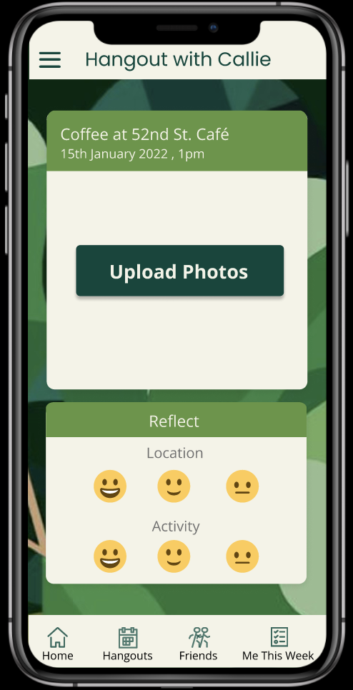
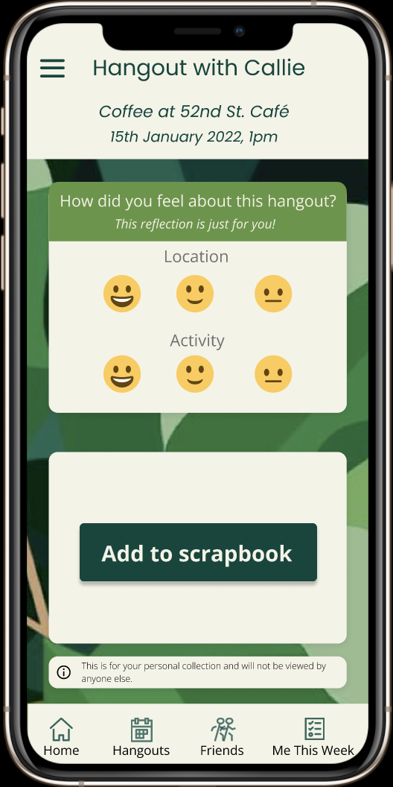
single friend design changes: severity 3 & 4
violation
Unclear what is being shared with friend and what is just for you, conflicts with privacy value
fix¹
Add text clarifications on reflection page to specify what is shared vs. what is just for user
1. Additional changes in revised design are minor changes detailed in appendix

Slide 9
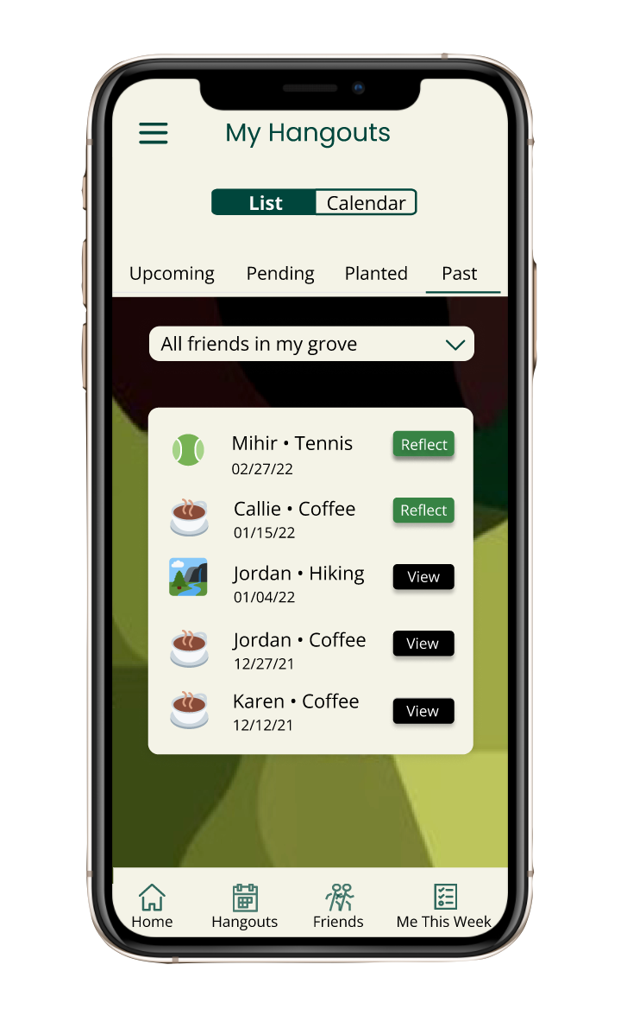
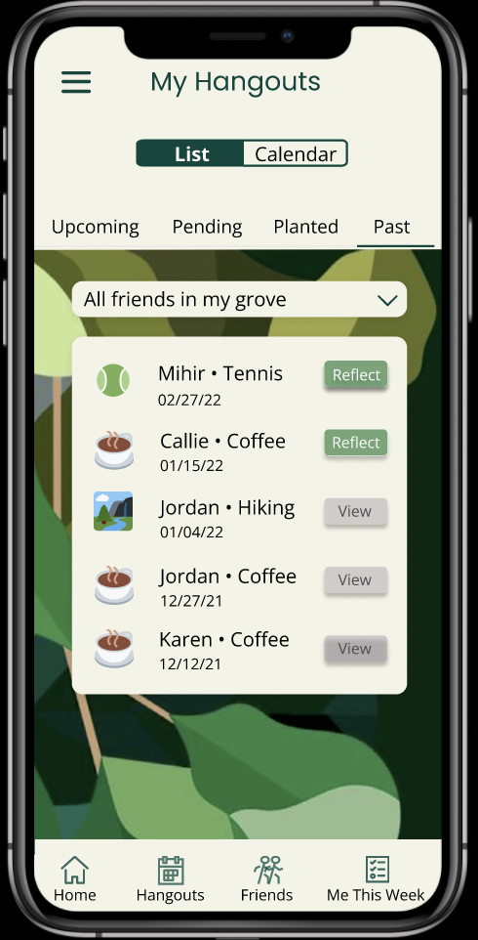


my hangouts design changes: severity 3 & 4
violation
Text/color combination on Reflect and View buttons are hard to read, fail color different/color contrast tests
fix
Modified color combinations to ensure greater contrast between background and text

Slide 10
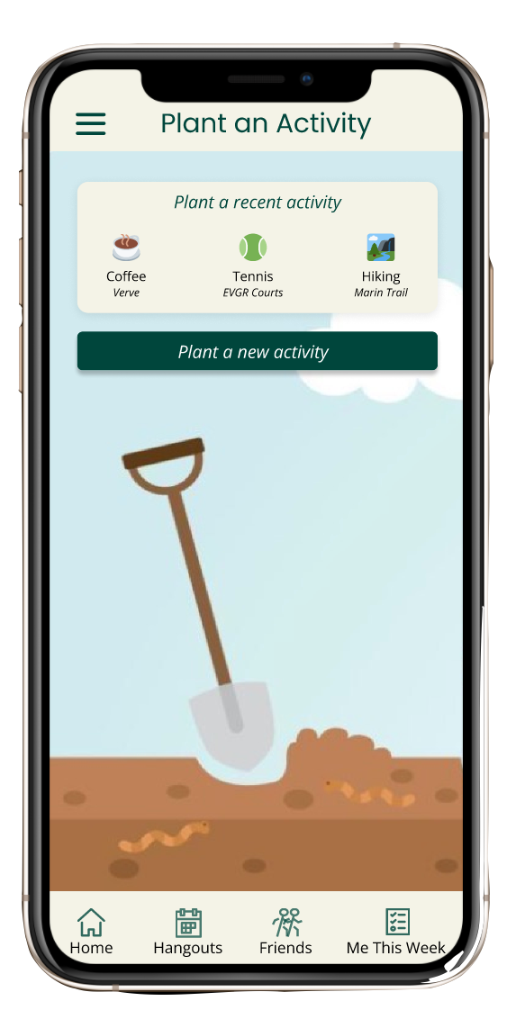
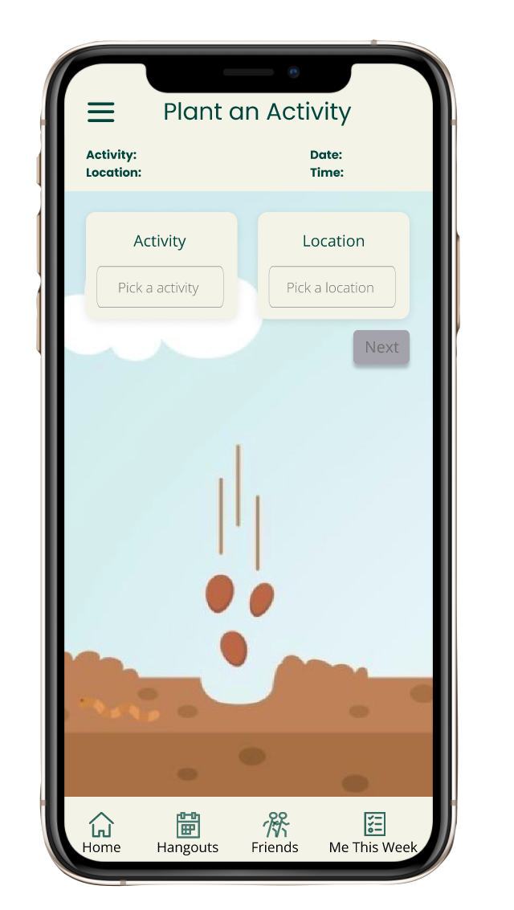
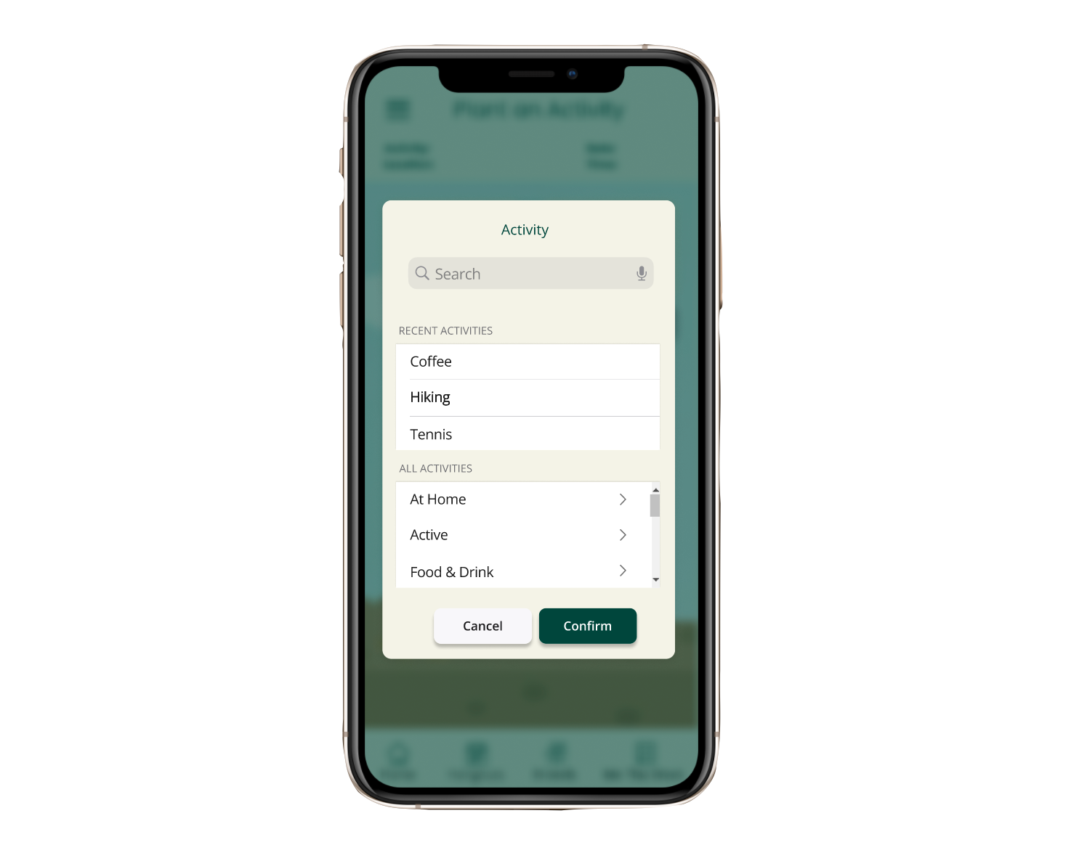
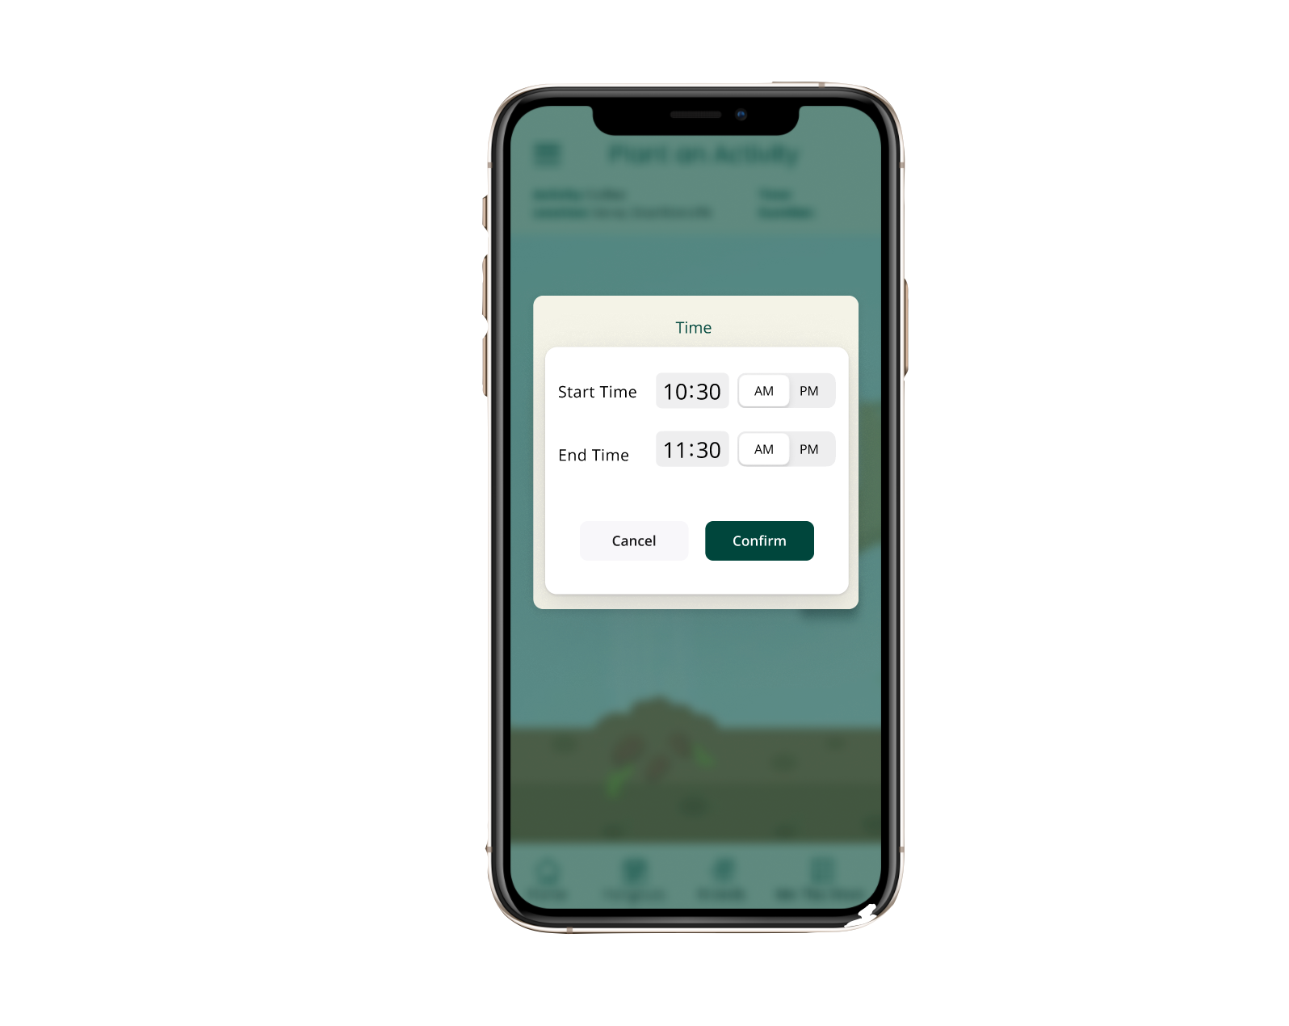
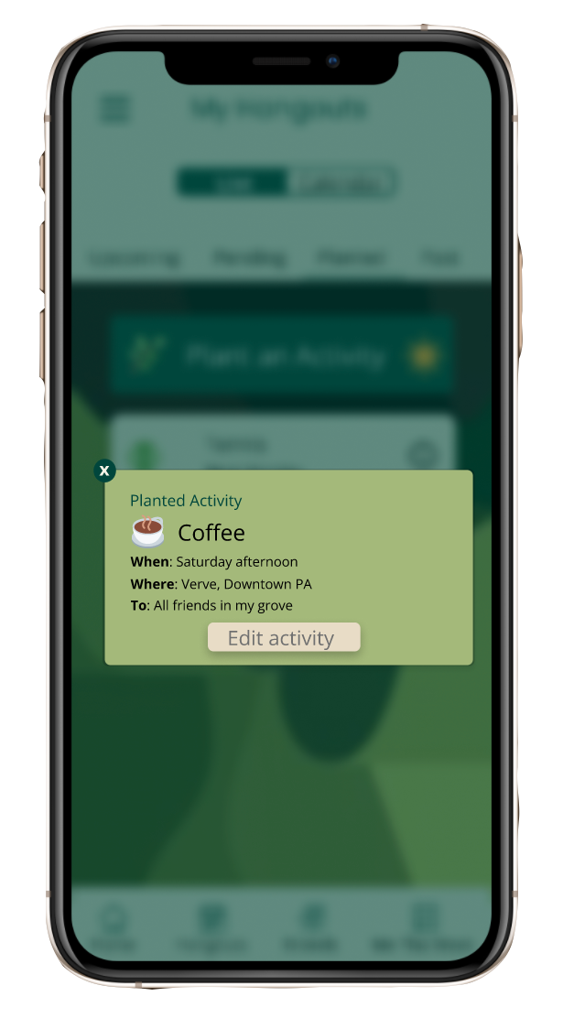
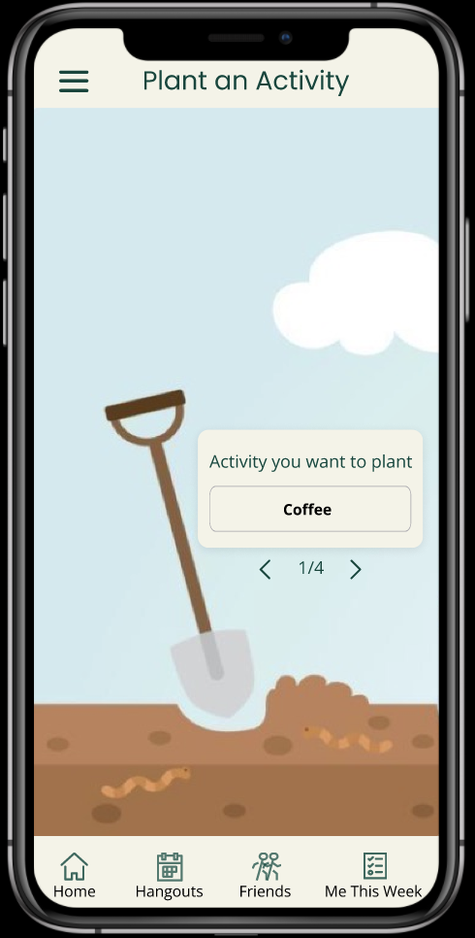
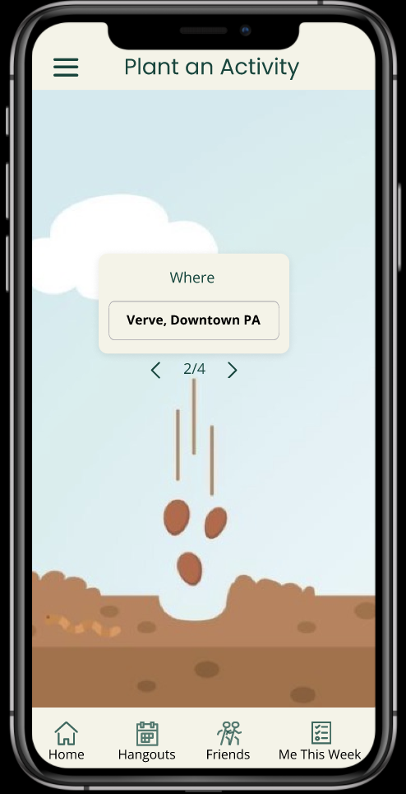
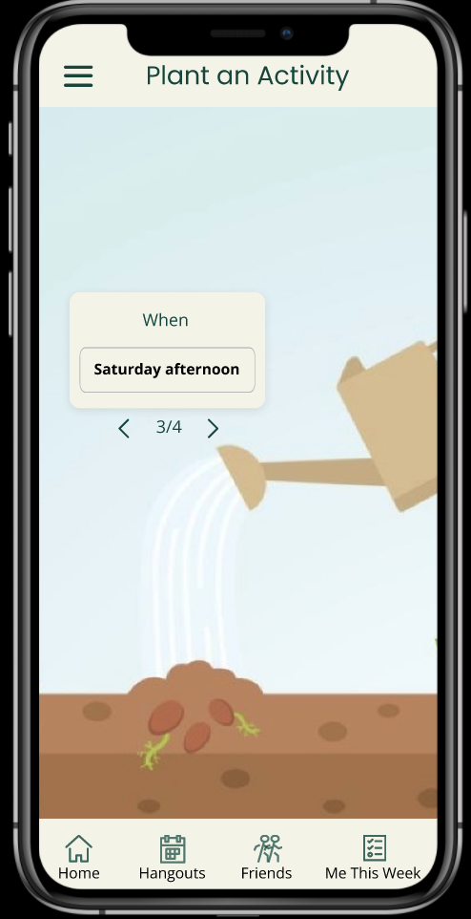
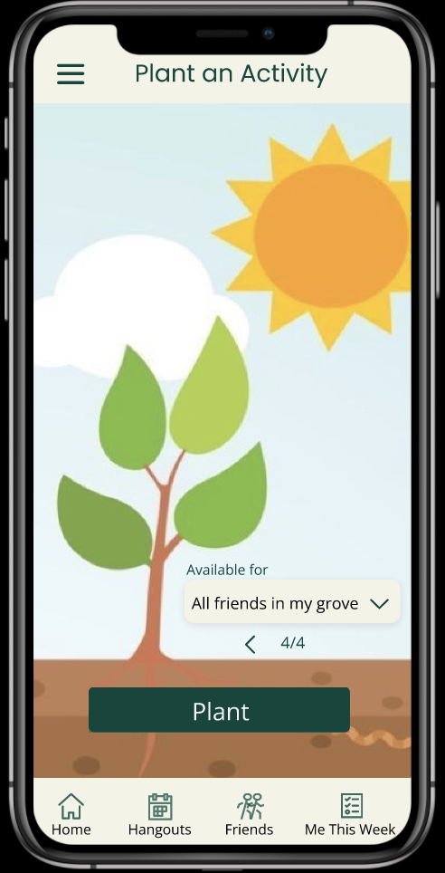
plant an activity design changes: severity 3 & 4
violations
No options for field inputs so user is unaware how specific they should be
Input fields are not in the same place, inconsistent as users go through process
Users cannot edit an activity they’ve planted
fixes¹
Provide options for activity, location, time/duration fields
Put all input fields in the same general area
Implement edit functionality on planted hangouts screen
1. Additional changes in revised design are minor changes detailed in appendix

Slide 11
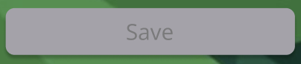
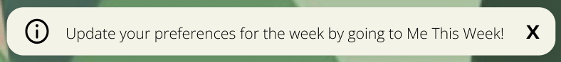
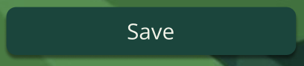
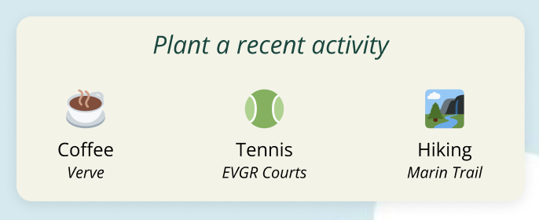
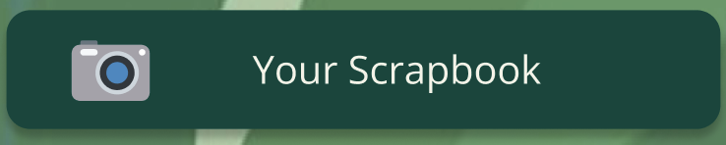
progress towards usability goals
robust
efficient
learnable
pleasing
Key metric: Able to complete tasks with minimal error rate.
Key metric: Able to complete tasks under specified time range.
Key metric: faster task completion over time.
Key metric: displaying positive signs of excitement during use.
Added confirmation dialog boxes and more real-time feedback to the user (e.g. dynamic ‘Save’ button).
Defined suggested options for activities, locations, and times that users can immediately select.
Added functionality to import previous user choices.
Added various info dialog boxes that provide further explanation / context about tasks.
Made subtasks more interactive/visual (e.g. selecting schedule on a grid instead of typing).
Implemented a user “scrapbook” of memories instead of just uploading photos/videos.

Slide 12
prototype implementation status

Slide 13






framework/tools
React Native
Redux
Expo Go
Github
Figma
Notion
for cross platform implementation of a native app
for state management
for speedy development
for collaboration and version control
for visualizing design changes
for task tracking

Slide 14
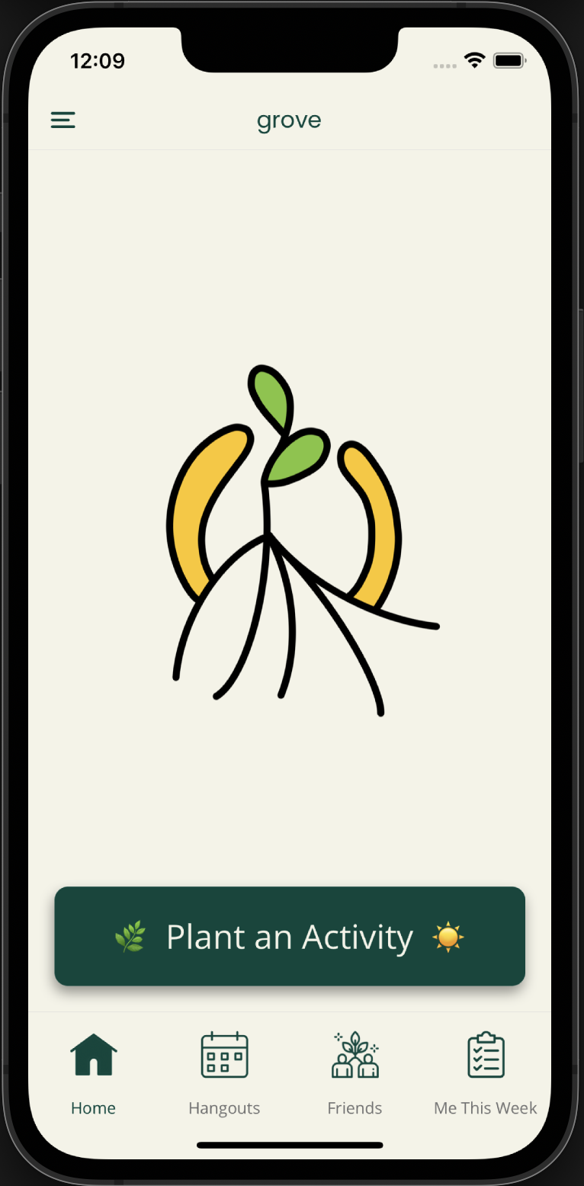
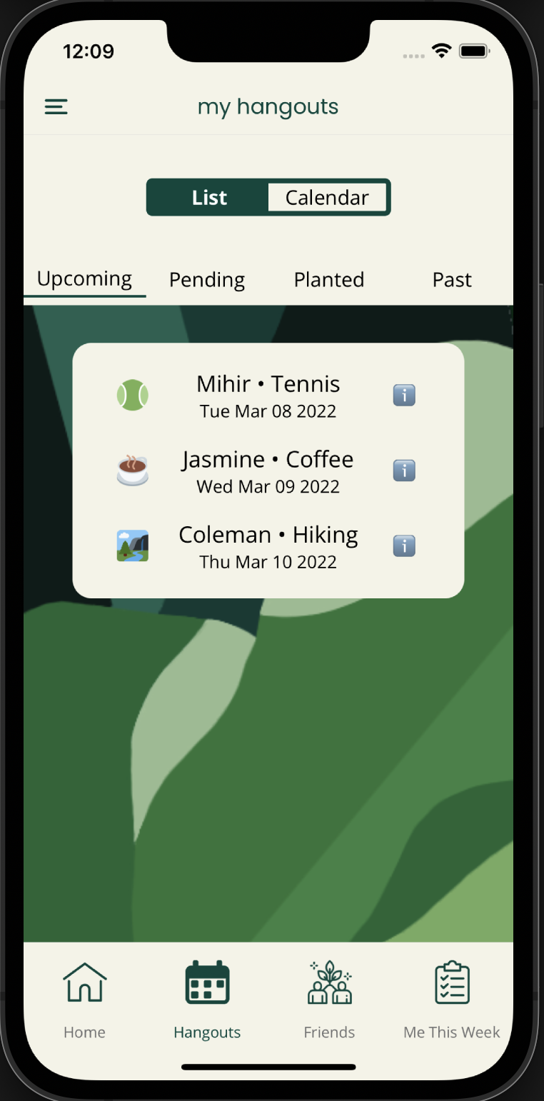
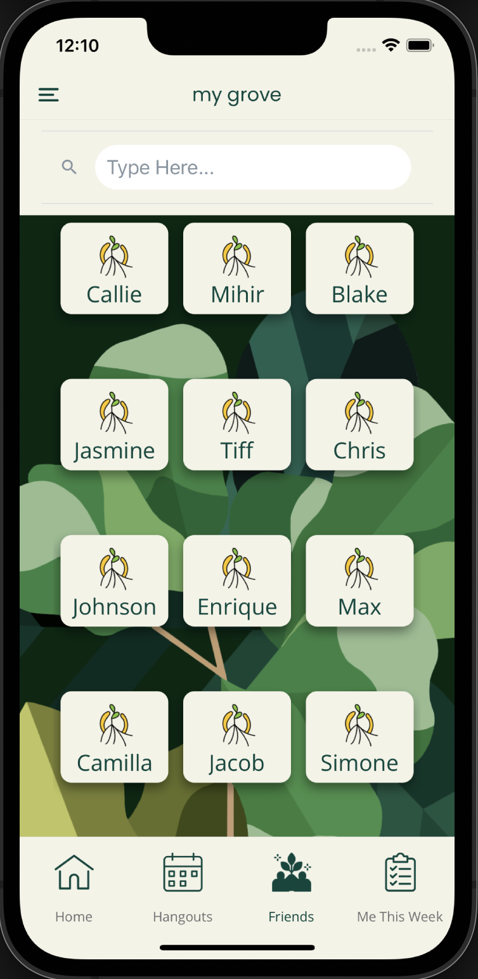
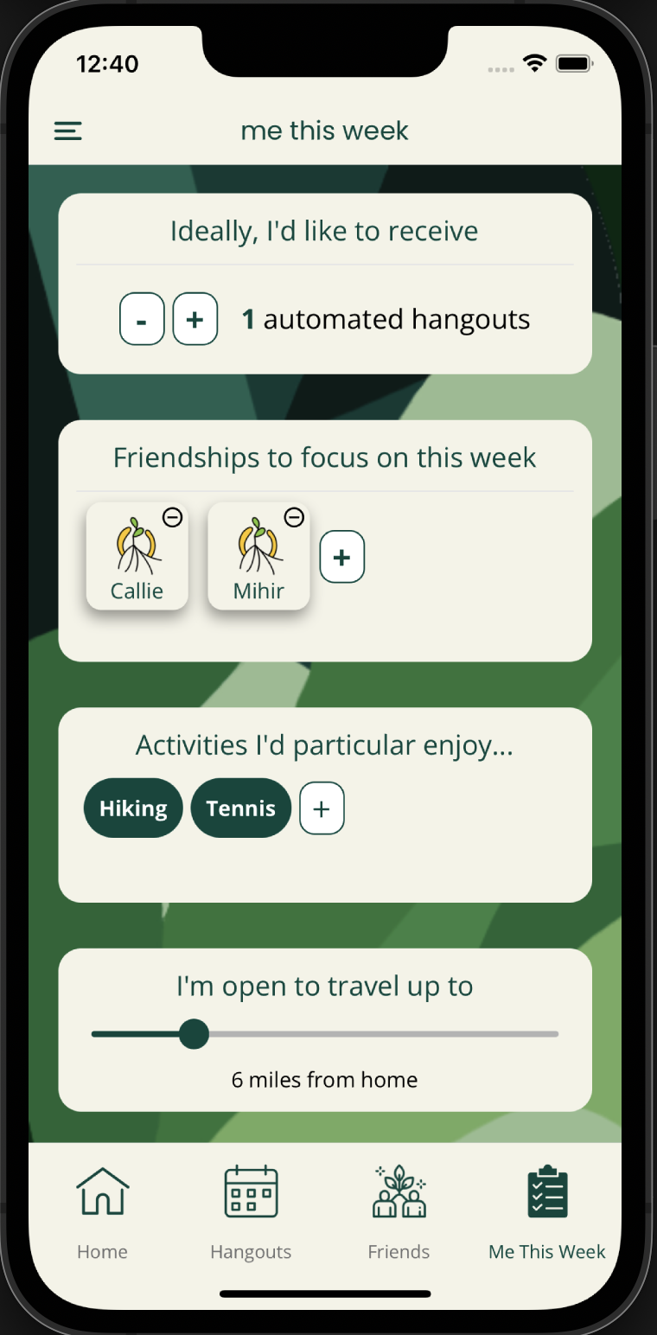
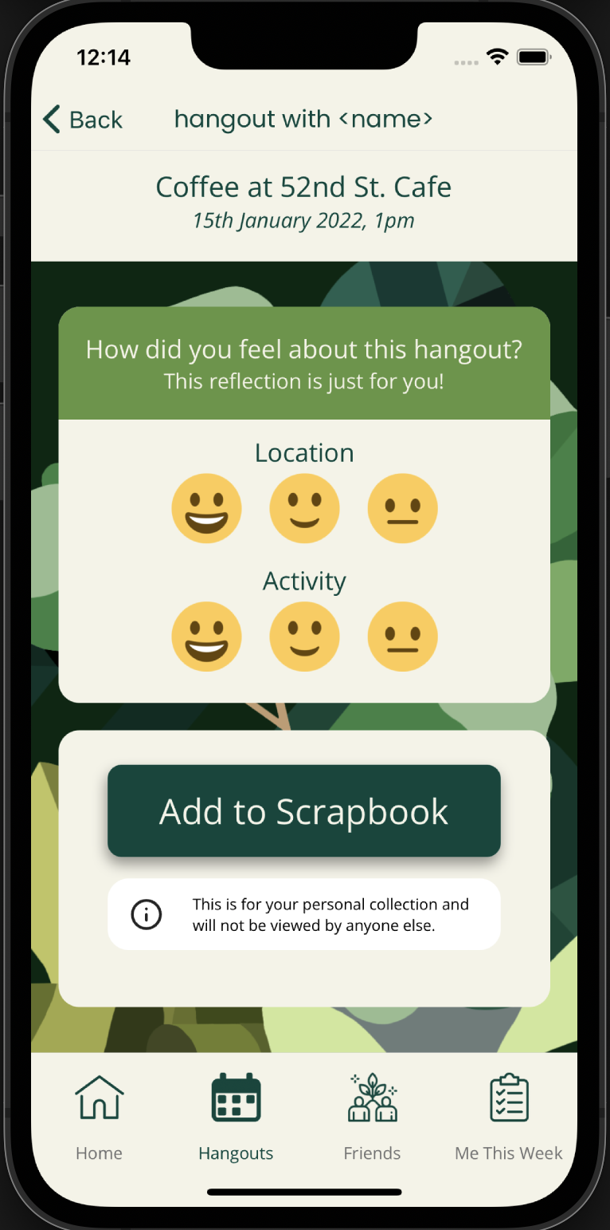
implemented features: screen progress
Implemented
Not implemented
single friend’s profile
flow for uploading a photo in reflection
flow for planting an activity
homescreen
my hangouts
my grove
me this week
reflection

Slide 15
implemented features: data architecture
user
activities
preferences
friends
Upcoming, Planted, Past, Pending, Reflected
Schedule, Preferred Activities, Friends to Focus on, etc.
Friend preferences, Strength of Friendship, etc.
complete
complete
work in progress

Slide 16
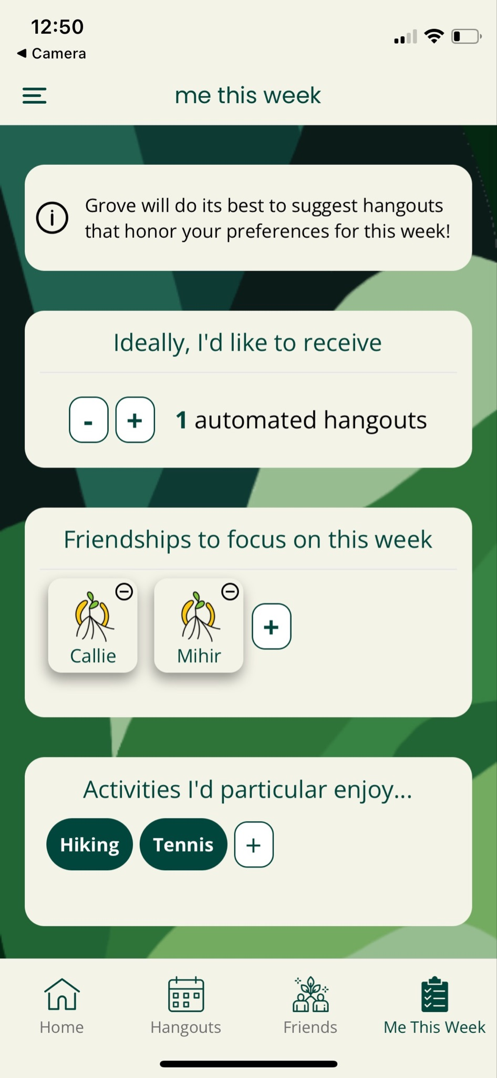
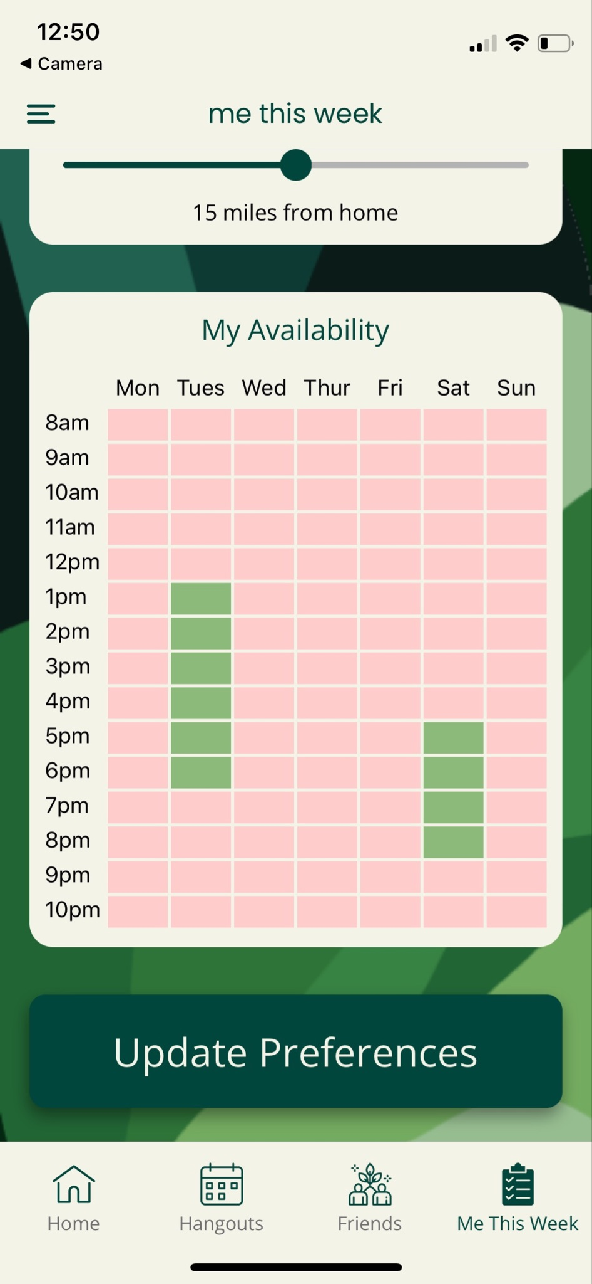
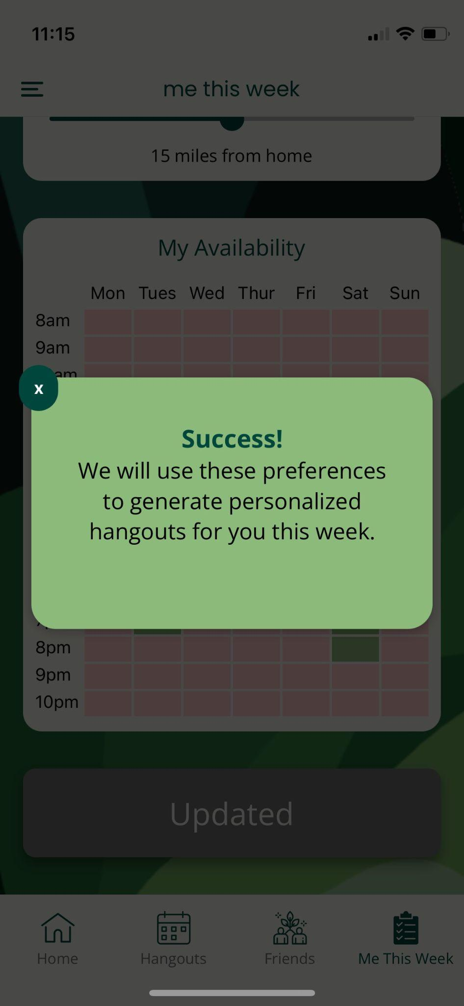
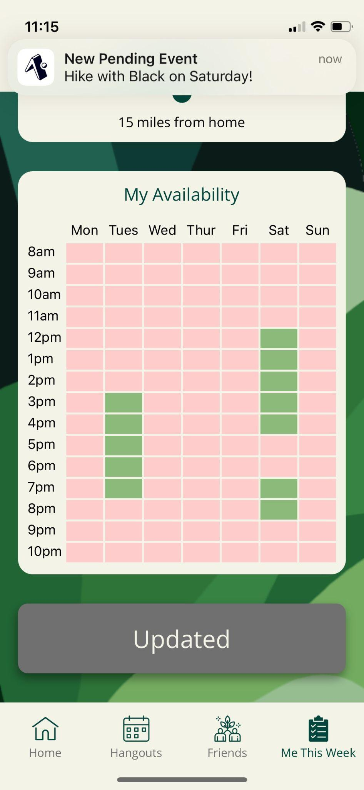
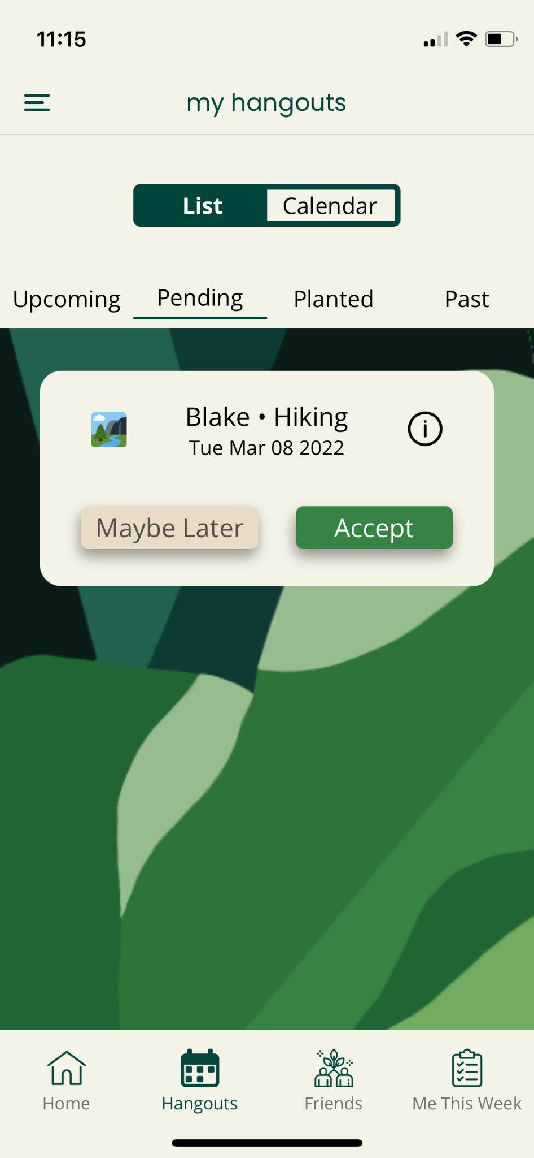
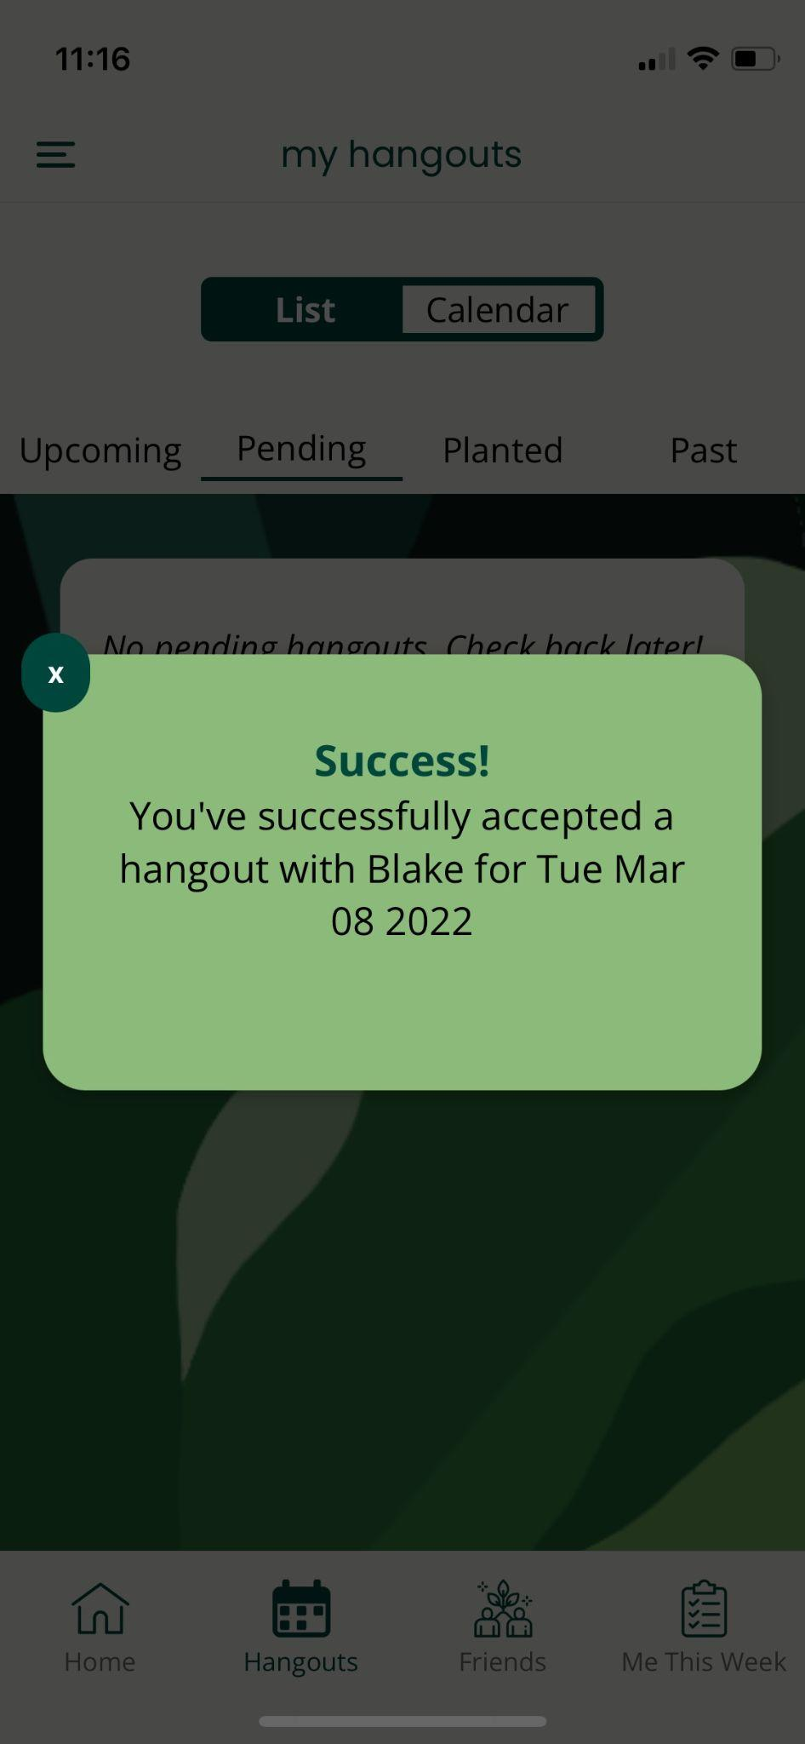
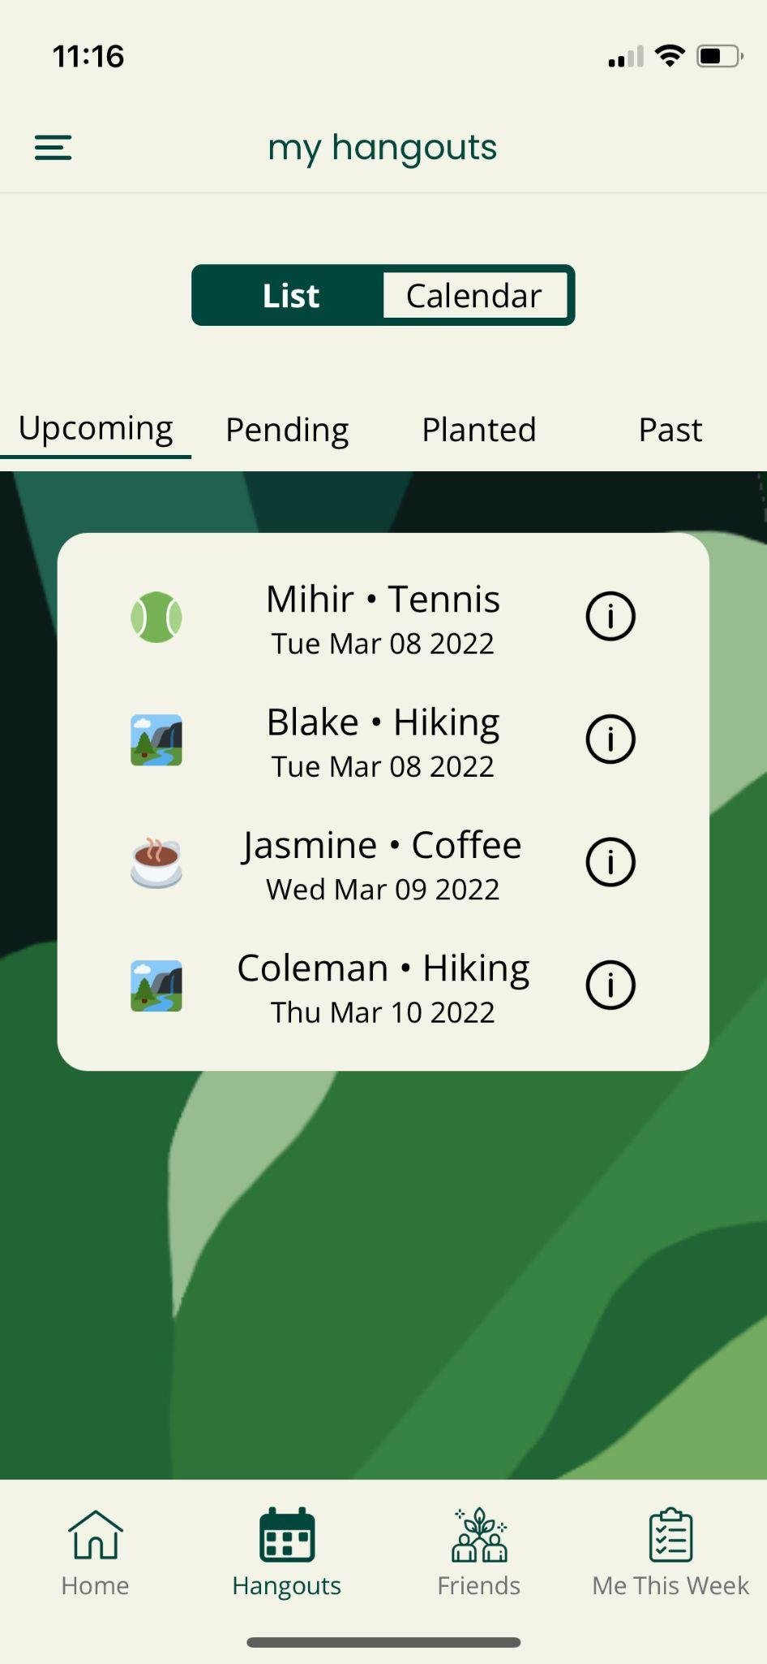
implemented features: task 1 flow
Set your activity and time preferences, and then accept a hangout that aligns with those preferences

Slide 17
plan for non-implemented features: gantt
Key | Due date | Not blocked | Blocked¹
Category | Task | Assignee | Weekend | Sun 3/6 | Mon 3/7 | Tues 3/8 | Wed 3/9 | Thu 3/10
Screen | Single Friend | Amelia
Screen | Plant an Activity | Chris
Screen | Upload a Memory | Amelia
Task 3 | Plant an Activity | Chris
Task 2 | Update Friend | Chris
Task 4 | Reflect | Amelia
Misc. | Profile
Misc. | Login
1. Cannot start until some other task is completed

Slide 18
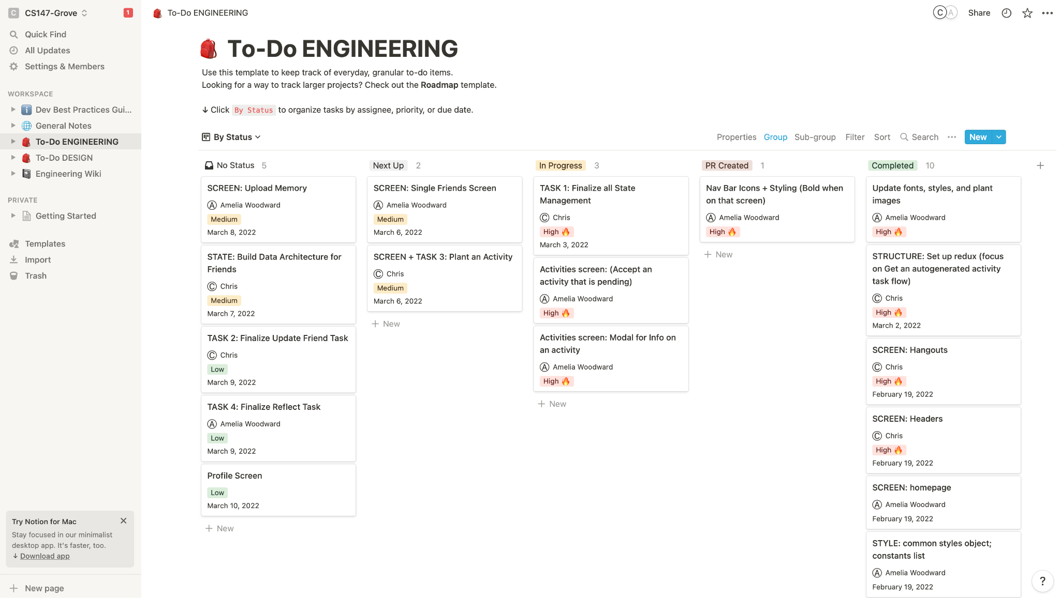
plan for non-implemented features: Notion

Slide 19
wizard of oz
automatic hangout generation
user creation; friend addition
Friends and previous activities already on platform as if the user has had the app for a while
Addition of activity is simply hard coded on frontend that aligns with preferred activities, illusion that it is generated automatically

Slide 20
hard coded data
limited activity types
friends
activity addition
Activities limited to Tennis, Hiking, Coffee, and Bar-Hopping
Currently have hard coded friend list rather than implement “Add Friend” feature
Currently the new activity is generated by us rather than automatically

Slide 21
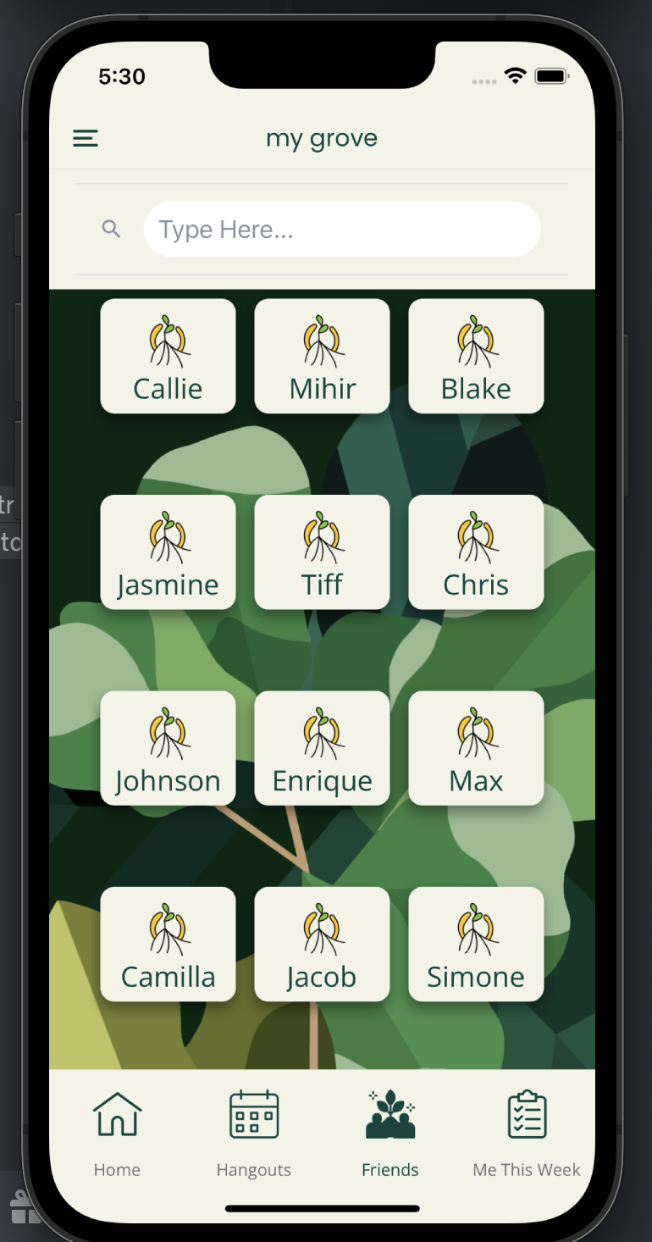
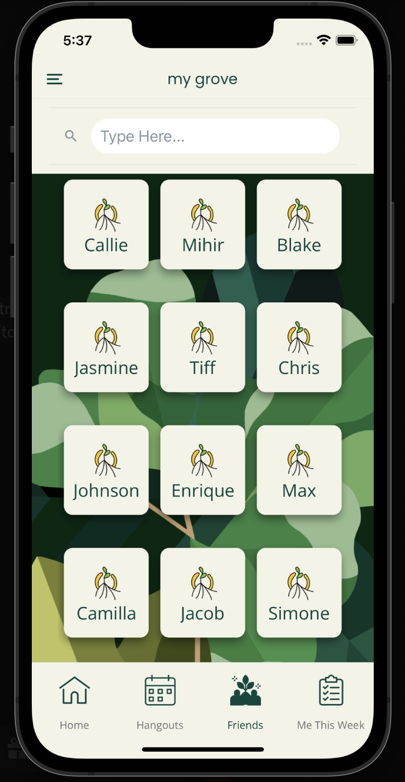
issues/questions - aesthetic query (1/2)
Smaller or larger friend cards?
... or are there other suggestions?
* We have no major technical queries, but would love aesthetic + accessibility input

Slide 22
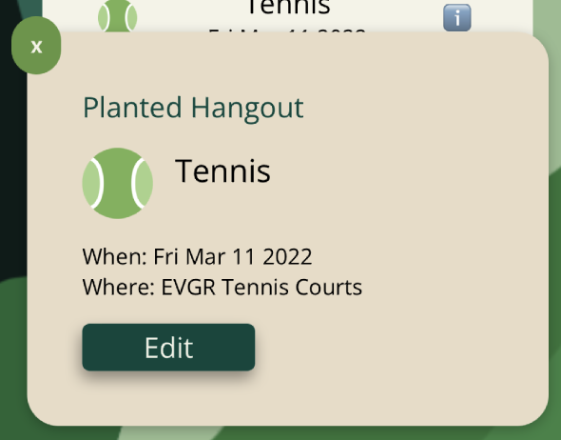
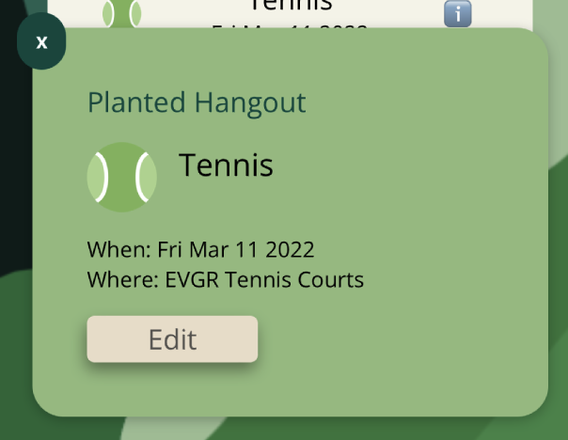
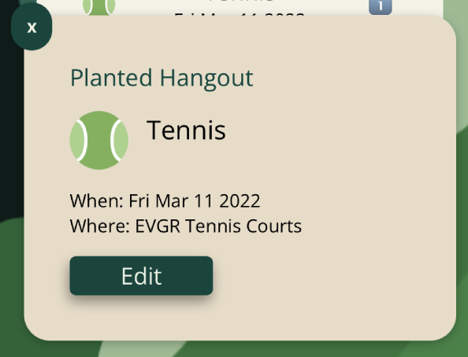
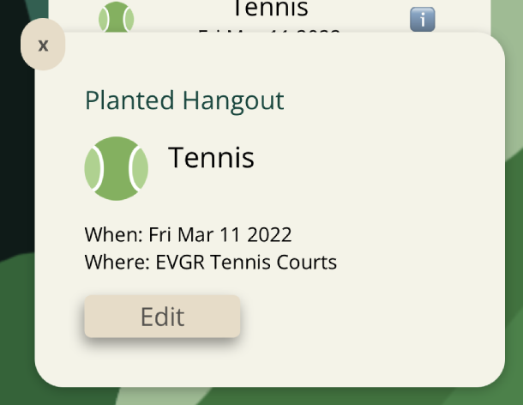
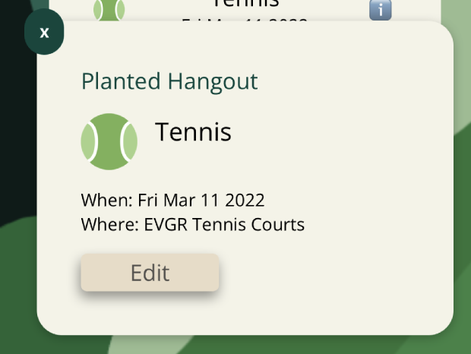
issues/questions - aesthetic query (1/2)
Color scheme for popups: which is your favorite?
... or are there other suggestions?
1
2
3
4
5

Slide 23
prototype demo

Slide 24
summary
7+ significant changes based on HE, several minor changes
Major progress made on task implementation
1/4 completed
2/4 close to completion
To implement:
Plant an Activity
Remainder of reflection flow
Solid plan in place to finish everything by the required deadlines

Slide 25
appendix

Slide 26
design changes - severity 1 & 2
overall
Replace profile picture with back button on sub-screens that are not accessible from the home bar to differentiate sub-screens from main screens
Standardize drop shadows and color (dark green, white text) on all clickable buttons
Standardize capitalization across app–titles are all lowercase
Fill in icon on bottom bar when you are on that page to make it easier to users to know where they are in the app
Increase text size on bottom bar
Move all Accept buttons to the right of Maybe Later (decline) buttons to make industry convention
homescreen
Add another card on home screen for upcoming activities so that logo takes up less space when there are no pending activities
my grove
Add another card on home screen for upcoming activities so that logo takes up less space when there are no pending activities

Slide 27
design changes - severity 1 & 2
plant an activity
Add 3 most recently done activities to first screen, so users have option to re-plant a recent activity vs. always creating a new one from scratch
Add area at the top of the screen to see progress of planted activity (what fields you’ve put in, what is left to put in)
Grey out “next” button on each screen until user makes a valid selection to provide feedback on when user has successfully done required action
Ensure inputted information persists when navigating back to screens user has already gone through
my hangouts
Make background a brighter green to be consistent with the colors of the other screens’ backgrounds
Implement ability for user to edit an activity
friend screen
Make text around frequency toggle larger
Move “Memories with friend” button up to beige portion of the screen as current button color does not stand out on green background

Slide 28
design changes - severity 1 & 2
reflection
Change “Reflect” to “How did you feel about this hangout?” to make it clear that user is reflecting on their emotions, makes smiley rating scale make more sense
Add visual tracker to photos so user knows how many they have left to write captions for (if they’d like to)–users able to scroll between photos and write captions before saving items to scrapbook
Make language on reflection task sound more reflective vs. like social media (“Notes” vs. “Caption)
Add option to delete photos you’ve added
Add save button so user knows when they’re photos, notes, and ratings have been acknowledged/saved by Grove
me this week
Move “+” to right-hand side everywhere to match industry convention (if “-“ exists, that should be on the left)
Add “-“ to top of each friend user’s added to priority list for option of removing such friends
All fields are now separate cards instead of nested drop downs so user can more easily see selections they’ve already made
Match language around priority friendships between me this week and friend page
Make availability tab look like When2Meet for more recognizable convention
Add “Save” button to the button of the screen. Greyed out until user makes a change, green when it needs to be clicked to save changes. If user tries to exit before saving, pop-up appears asking user if they want to save before moving on

Slide 29
not addressed: severity 1 & 2
violation
Background images are distracting. Suggested to remove them as background images and have them only in headers.
rationale
Background images are imperative to carrying out plant metaphor. To work to ensure backgrounds are not distracting (since we’re keeping them), we’ve worked to standardized location/styles of input fields/buttons, and ensure high contrast of these items so they don’t blend into background.

Slide 30
not addressed: severity 1 & 2
violation
Lack of feedback on how many hangouts the user has done out of the number user indicated wanting to do that week in “Me this week” makes the goal seem floating / unable to accomplish. Number of hangouts are indicated at the beginning of the week to inform grove of how many hangouts to suggest to the user, it is not a goal that the user is setting for themselves.
rationale
This fact is made more clear by adding info at the top of the screen that grove will do its best to honor those preferences, so user knows this information is more for the app than themselves. Tracker would be a nice-to-have feature, but is not core to our tasks.

Slide 31
not addressed: severity 1 & 2
violation
Hangouts tabs “Upcoming”, “Pending”, “Planted” and “Past” are competing dialogues. Suggested to put “Confirmed”, “Pending” and “Planted” activities all under “Upcoming” and just have “Upcoming” and “Past” top level categories.
rationale
“Upcoming”, “Pending”, “Planted” and “Past” are all distinct categories. “Upcoming” denotes hangouts that are confirmed but haven’t been completed, “Pending” are hangouts generated for the user or sent to the user by a friend in their grove that they have yet to accept or reject. “Planted” are hangouts that the user planted but haven’t been confirmed yet (so therefore this is separate from “Upcoming”), and “Past” are hangouts that have been completed. Additionally, all categories refer to separate tasks.

